Slide 1
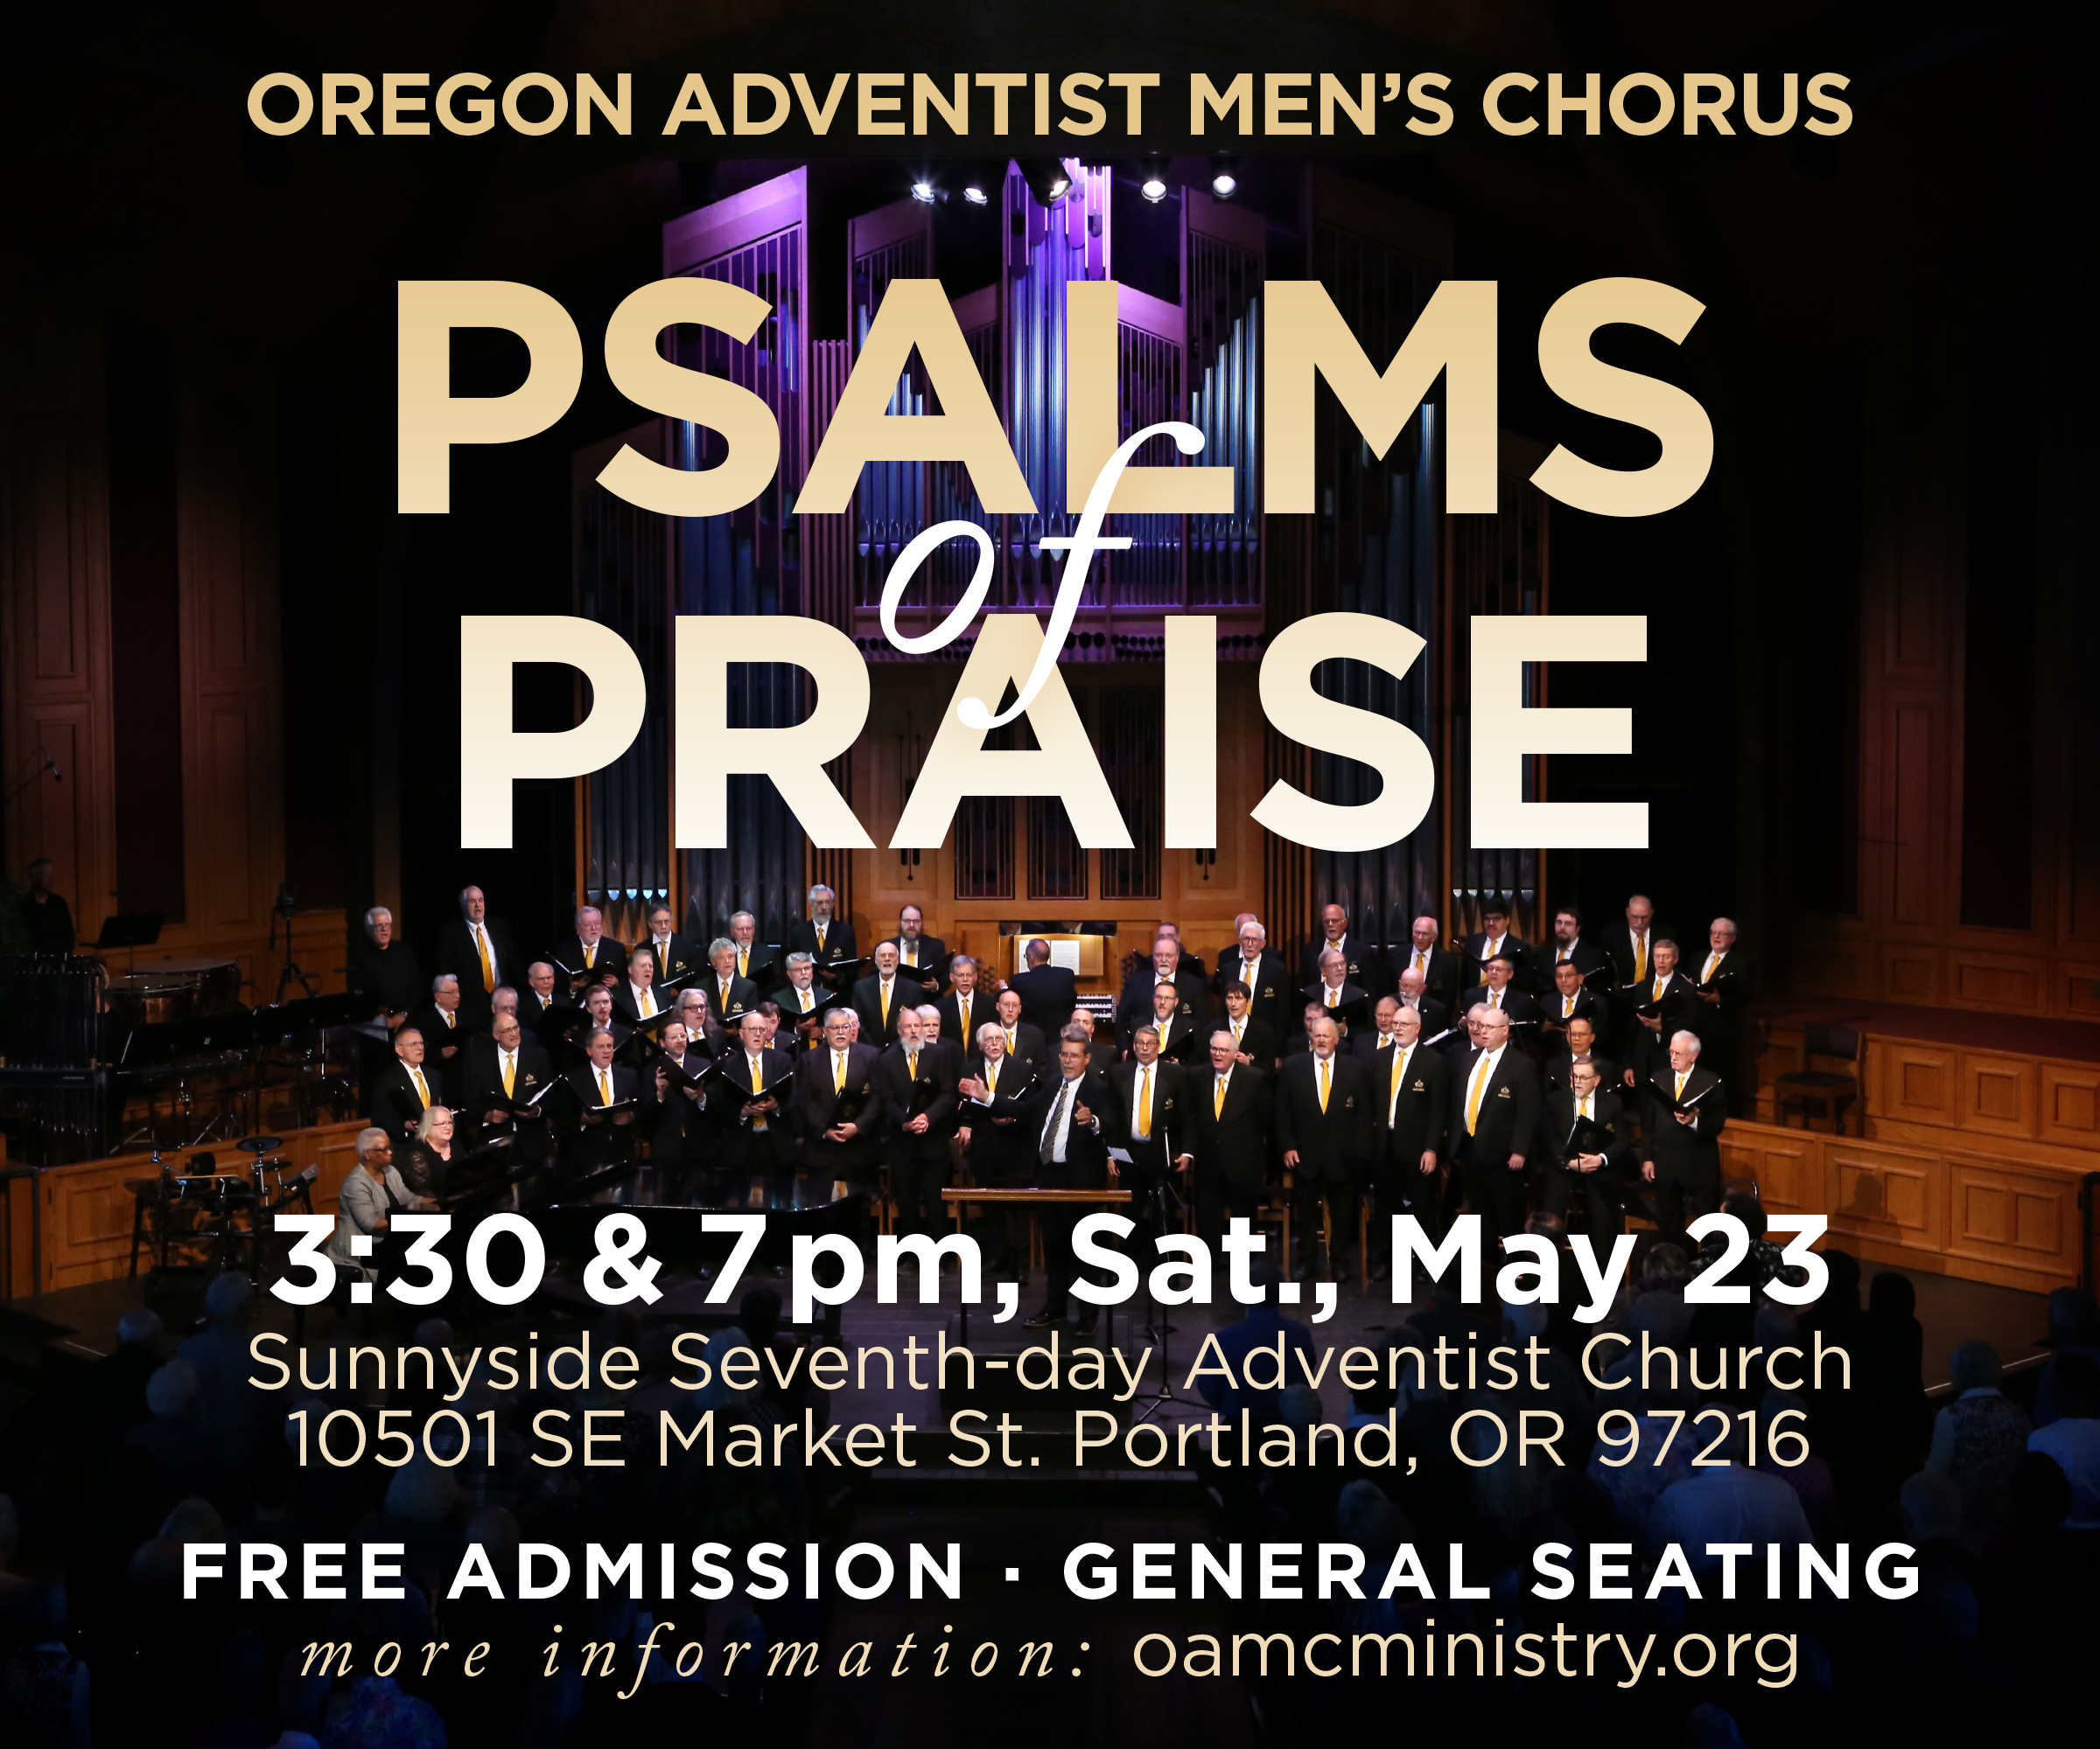

You’re Invited!
Invite a friend for this inspirational event
Free to the public
Notes:
You’re welcome to use any and all of these slides.

Slide 2
You’re Invited!
Members in OAMC:
John Doe
Jack Doe
Jim Doe
Tom Doe
Free to the public
Notes:
You’re welcome to customize this slide with the names of your church members who are singing in the OAMC concert.

